Slide 1
DNA Computation simulator
Harnessing DNA Computing for Network Analysis

Slide 2
Introduction
What is DNA Computing?
An innovative computation model using DNA, biochemistry, and molecular biology.
Offers potential advantages in parallel processing and problem-solving.
Project Objective:
Encode a network structure into a DNA sequence utilizing an Adleman-like algorithm.
Explore Hamiltonian paths in the encoded network.
Visuals: Use an infographic to illustrate the concept of DNA computing

Slide 3
Project goals
Primary Goals:
Implement a robust DNA encoding algorithm.
Encode network nodes and edges into DNA sequences.
Identify and visualize Hamiltonian paths within the network.
Target Audience:
Researchers and practitioners in bioinformatics and computational biology.
Visuals: Use icons to represent each goal for a more engaging layout.

Slide 4
methodology
Input:
Directed graphs as edge lists (e.g., cities graph).
Encoding Steps:
Node Encoding: Generate random DNA sequences.
Edge Encoding: Combine sequences of connected nodes.
Complement Generation: Create complementary sequences for each node.
Technologies Used:
Python, NetworkX, Pydna, Matplotlib.
Visuals: Include a flowchart to visualize the encoding process.

Slide 5
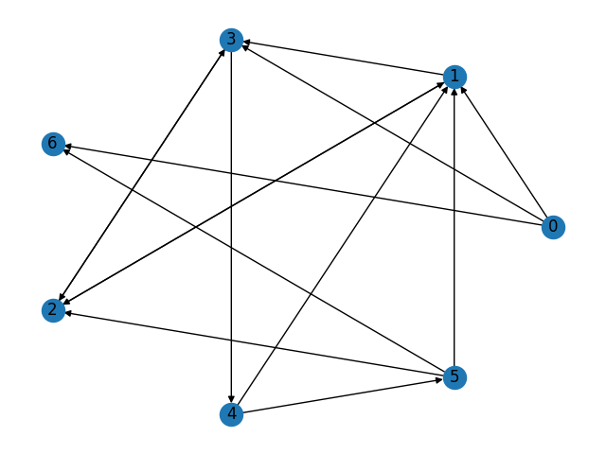
Graph Representation
Example Graph:Showcase a simple graph (e.g., a network of cities).
File Structure:Explain the edge list format (e.g., how cities are connected in cities.txt).
Graph Visualization:Discuss the importance of visualizing graphs for better understanding.
Visuals: Include an actual graph image alongside the text description.

Slide 6
DNA encoding process
Node Encoding:Explain the random DNA sequence generation for each node.
Edge Encoding:Detail how edges are represented by the sequences of connected nodes.
Complement Generation:Describe the method for generating complementary DNA sequences.

Slide 7
visualization
Graph Visualization:Show how graphs are visually represented using Matplotlib.
Example Outputs:Display the circular representation of the graph and output images saved during the process.

Slide 8
results
Hamiltonian Path Detection:Summarize the detection results from various graphs.
Sample Outputs:Provide snippets of console outputs showcasing findings.
Impact of Results:Discuss how these results contribute to understanding network structures.

Slide 9
Conclusion
The DNA encoding algorithm presented in this project demonstrates a novel approach to encoding graph data using DNA sequences. By leveraging the unique properties of DNA, such as its vast information storage capacity and parallel processing capabilities, this algorithm explores the potential for biological computation in solving complex graph problems.

Slide 10
Thank You

